Slide 1
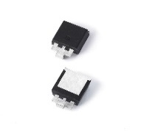
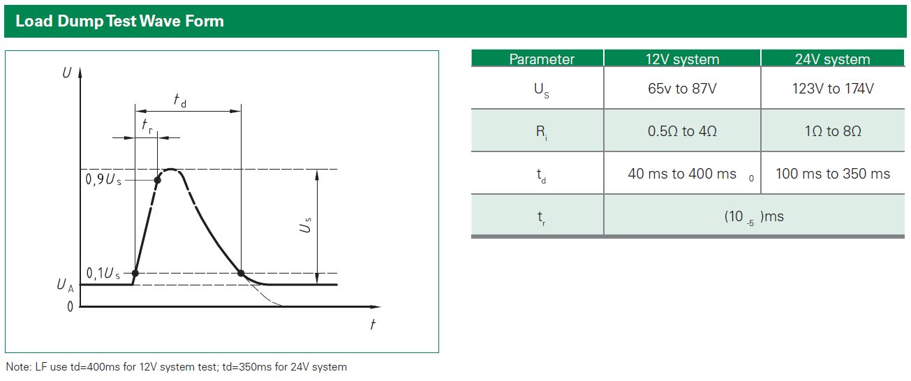
SLD6S Surface Mount TVS Diode for High Power Automotive Load Dump Protection
Problem/Solution
The SLD6S unidirectional TVS Diode series is designed to protect sensitive electronics against ESD, EFT, 10/1000 surge events and inductive load switching voltage transient events. Housed in an SMTO-263 package with lead modifications, it is ideal for severe automotive load dump applications.
Features and Benefits
Quality assurance through AEC-Q101 qualification and PPAP compliance
SMTO-263 package, and footprint is compatible to industrial popular DO218AB package
Meet ISO7637-2 5a/5b protection, ISO16750 and JASO D-001 load dump test
4600W peak pulse power capability at 10/1000μs waveform
6W power dissipation on infinite heatsink at TA= 25 °C
Technical resources (Click on below icons to learn more)
Series Page
Datasheet
Application Note
Markets/Applications
Designed to protect sensitive automotive electronics from:
Inductive Load Switching
Alternator Load Dump

