Slide 1
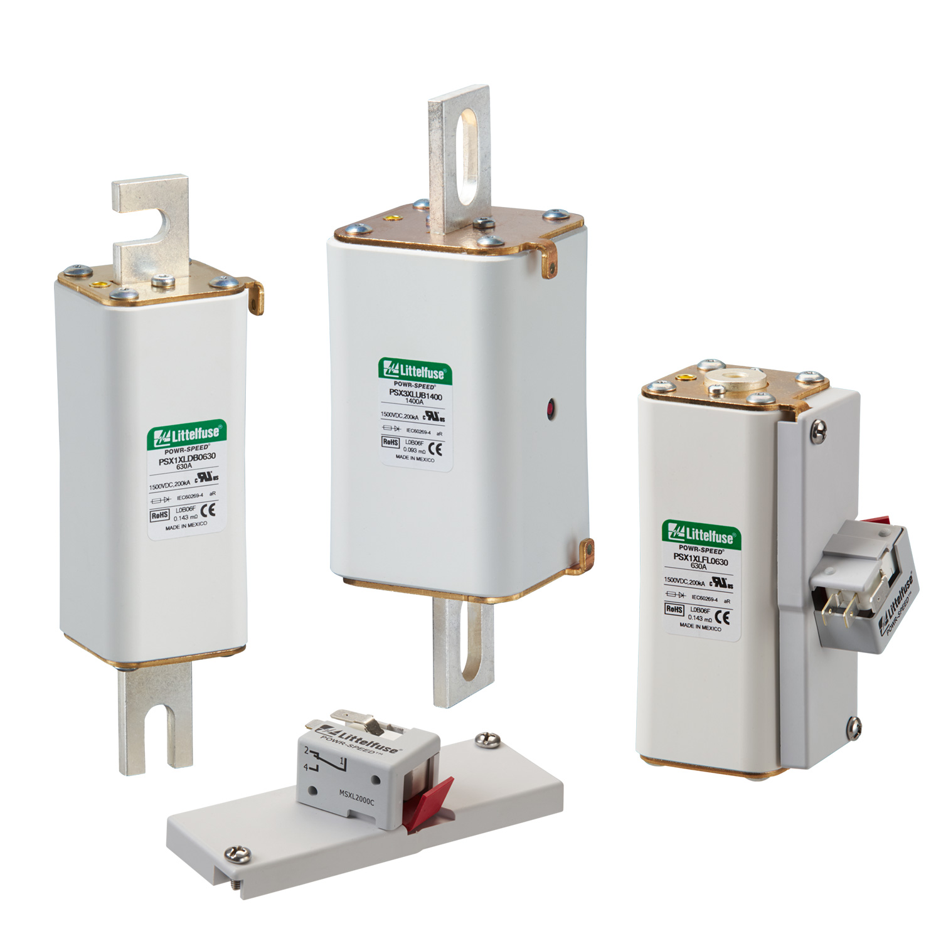
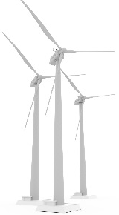
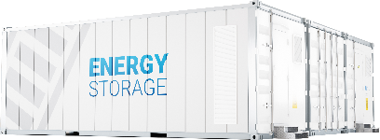
PSX series: extremely fast-acting with 200 kA DC interrupting ratings and DC voltage up to 1500 V DC
Problem/Solution
The PSX series high-speed fuses deliver extremely fast-acting performance up to 1500 V dc. Available in flush-end, DIN-mount, and bolted-blade styles, they are the smallest NH XL package size on the market and range from 80 A to 1400 A. The PSX series is extremely fast-acting with 200 kA DC interrupting ratings. They are certified to UL 248-13 and designed to meet EN high-speed semiconductor fuse standard and IEC 60269-7, a new battery protection fuse standard in development.
Benefits
Low watts loss, prevents energy loss, more efficient, minimizes wasted power from components
Small package facilitates design of smaller or more compact high energy density systems
Visual blown fuse indication is detectable in the event of a fault
High Interrupting rating provides improved protection levels
Features
High dc voltage rating up to 1500 V dc & interrupting rating 200 kA*
Extremely fast acting (high-speed performance)
Low watt loss (energy efficiency for BESS applications)
Compact NH 1XL and 3XL sizes
Class aR performance according to IEC 60269-4
Technical resources:
Series Page
Datasheet
Tech info
Markets/Applications
Battery energy storage systems
Power Conversion Systems
Dc common bus systems
Industrial heaters and welding equipment
Hybrid PV-BESS Inverters
Regenerative drives
Metal processing equipment

